Slide 1
Understanding Behavior Trees. Introduction to BT-AP Approach And Application in SuperMario Game Scenario

Slide 2
What are Behavior Trees?
“A Behavior Tree (BT) is a way to structure the switching between different tasks in an autonomous agent“ [1]
What is wrong with FSMs? The Need for Reactiveness and Modularity
Reactiveness: ability to quickly and efficiently react to changes
Modularity: degree to which a system‘s components may be separated into building blocks and recombined
„one-way control are an„invitation to make a mess of one‘s program“ - Dijkstra
Notes:
GoTo Statement is an example of a so-called oneway control transfer, where the execution of a program jumps to another part of the code and continue executing from there. GoTo statements are harmful, since If for example one component is removed, every transition to that component needs to be revised.

Slide 3




Formulation of BTs (I)
Control Flow Nodes
Execution Nodes
Sequence
Fallback/
Selector
Condition
Action
Decorator
Parallel

Slide 4
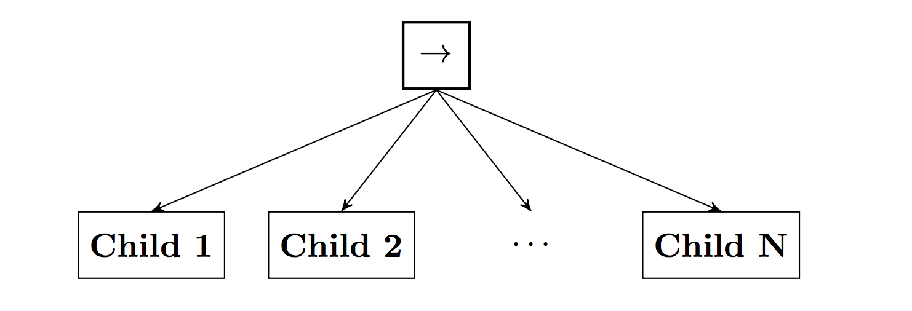
Formulation of BTs (II)
A BT starts its execution from the root node that generates ticks with a given frequency which are sent to its children. A node is executed if and only if it receives ticks.
The child immediately returns to the parent the status Running, Success or Failure.
Figure 1. Graphical representation of a Sequence node with N children

Slide 5
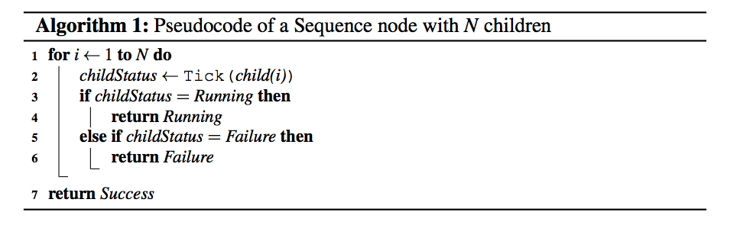
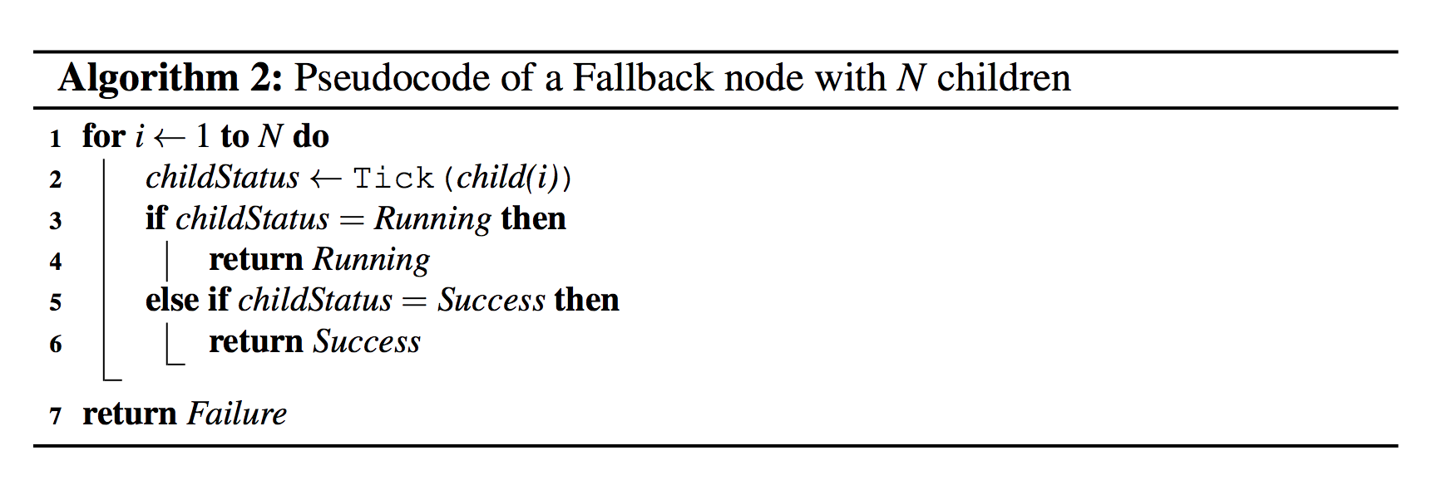
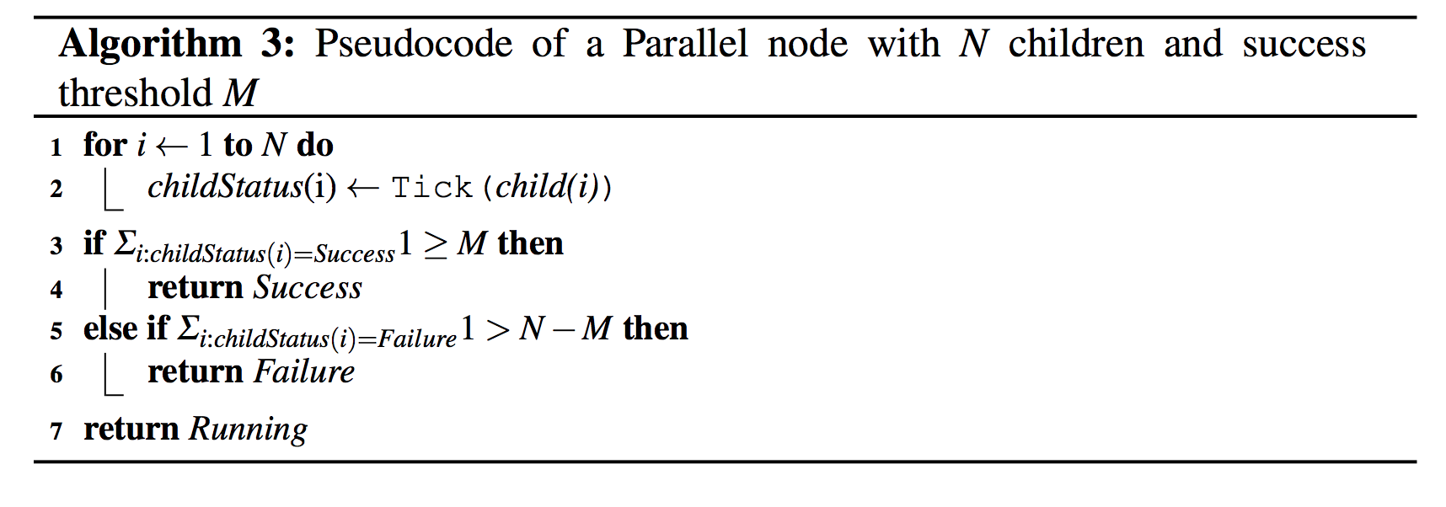
Formulation of BTs (III)
Notes:
The Sequence node executes Algorithm 1, which corresponds to routing the ticks to its children from the left until it finds a child that returns either Failure or Running, then it returns Failure or Running accordingly to its own parent. It returns Success if and only if all its children return Success.
The Fallback node executes Algorithm 2, which corresponds to routing the ticks to its children from the left until it finds a child that returns either Success or Running, then it returns Success or Running accordingly to its own parent. It returns Failure if and only if all its children return Failure. Note that when a child returns Running or Success, the Fallback node does not route the ticks to the next child (if any)
The Parallel node executes Algorithm 3, which corresponds to routing the ticks to all its children and it returns Success if M children return Success, it returns Failure if N − M +1 children return Failure, and it returns Running otherwise, where N is the number of children and M ≤ N is a user defined threshold.
Action node: When it receives ticks, it executes a command. It returns Success if the action is correctly completed or Failure if the action has failed. While the action is ongoing it returns Running.
Condition node: when it receives ticks, it checks a proposition. It returns Success or Failure depending on if the proposition holds or not. Note that a Condition node never returns a status of Running. The
Decorator node is a control flow node with a single child that manipulates the return status of its child according to a user-defined rule and also selectively ticks the child according to some predefined rule. For example, an invert decorator inverts the Success/Failure status of the child; a max-N-tries decorator only lets its child fail N times, then always returns Failure without ticking the child; a max-Tsec decorator lets the child run for T seconds then, if the child is still Running, the Decorator returns Failure without ticking the child

Slide 6
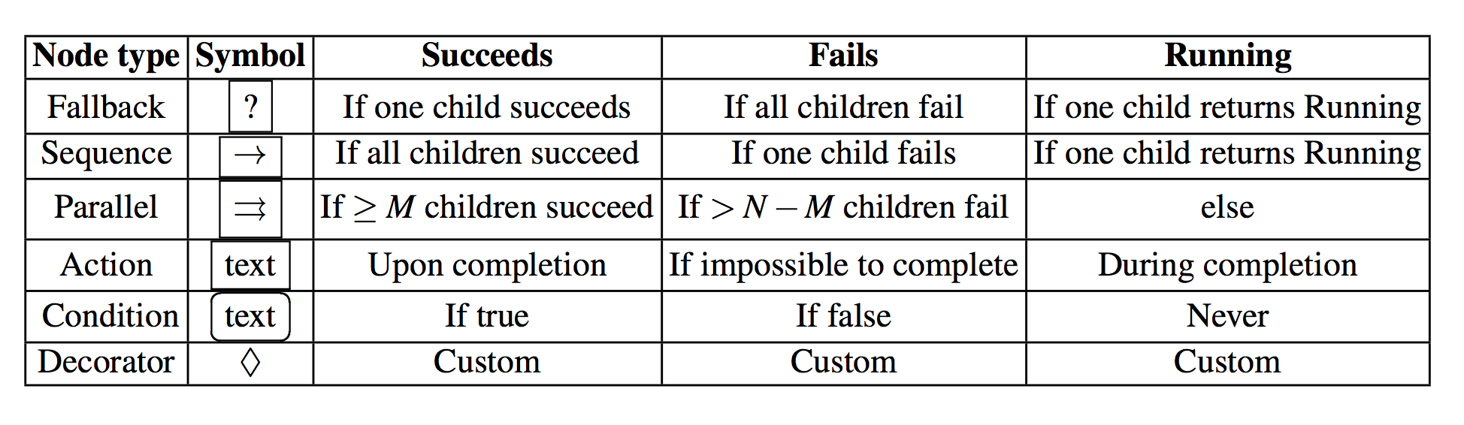
Formulation of BTs (III)
Notes:
The Sequence node executes Algorithm 1, which corresponds to routing the ticks to its children from the left until it finds a child that returns either Failure or Running, then it returns Failure or Running accordingly to its own parent. It returns Success if and only if all its children return Success.
The Fallback node executes Algorithm 2, which corresponds to routing the ticks to its children from the left until it finds a child that returns either Success or Running, then it returns Success or Running accordingly to its own parent. It returns Failure if and only if all its children return Failure. Note that when a child returns Running or Success, the Fallback node does not route the ticks to the next child (if any)
The Parallel node executes Algorithm 3, which corresponds to routing the ticks to all its children and it returns Success if M children return Success, it returns Failure if N − M +1 children return Failure, and it returns Running otherwise, where N is the number of children and M ≤ N is a user defined threshold.
Action node: When it receives ticks, it executes a command. It returns Success if the action is correctly completed or Failure if the action has failed. While the action is ongoing it returns Running.
Condition node: when it receives ticks, it checks a proposition. It returns Success or Failure depending on if the proposition holds or not. Note that a Condition node never returns a status of Running. The
Decorator node is a control flow node with a single child that manipulates the return status of its child according to a user-defined rule and also selectively ticks the child according to some predefined rule. For example, an invert decorator inverts the Success/Failure status of the child; a max-N-tries decorator only lets its child fail N times, then always returns Failure without ticking the child; a max-Tsec decorator lets the child run for T seconds then, if the child is still Running, the Decorator returns Failure without ticking the child

Slide 7
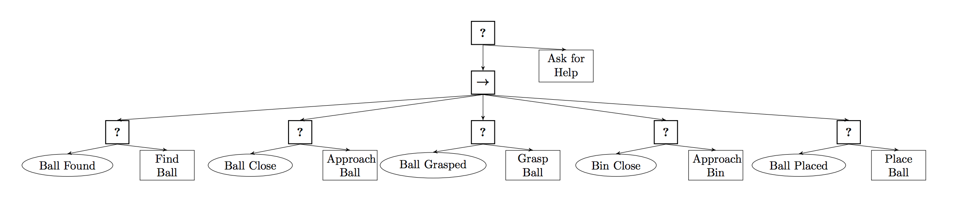
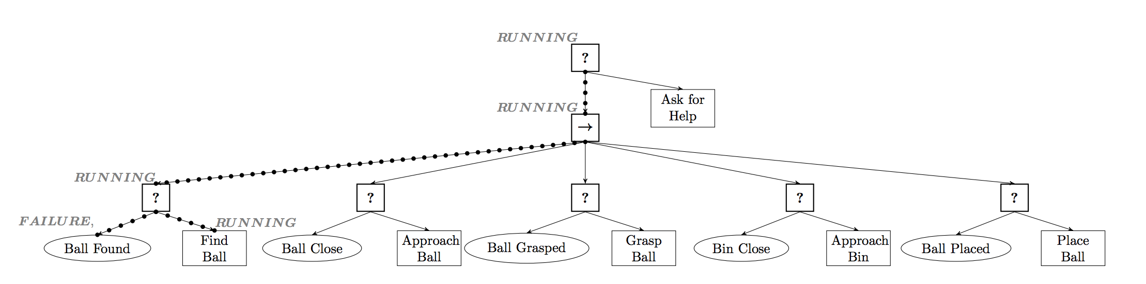
Execution Example of a BT (I)
Figure 2. BT designed to make an agent look for a ball, approach it, grasp it, proceed to a bin, and place the ball in the bin.
Figure 2 (a). Ticks’ traversal when the robot is searching the ball.
Notes:
Figure 2 (a). The ticks traverse the BT reaching the condition node Ball Found. The agent does not know the ball position hence the condition node returns Failure and the ticks reach the Action Find Ball, which returns Running.

Slide 8
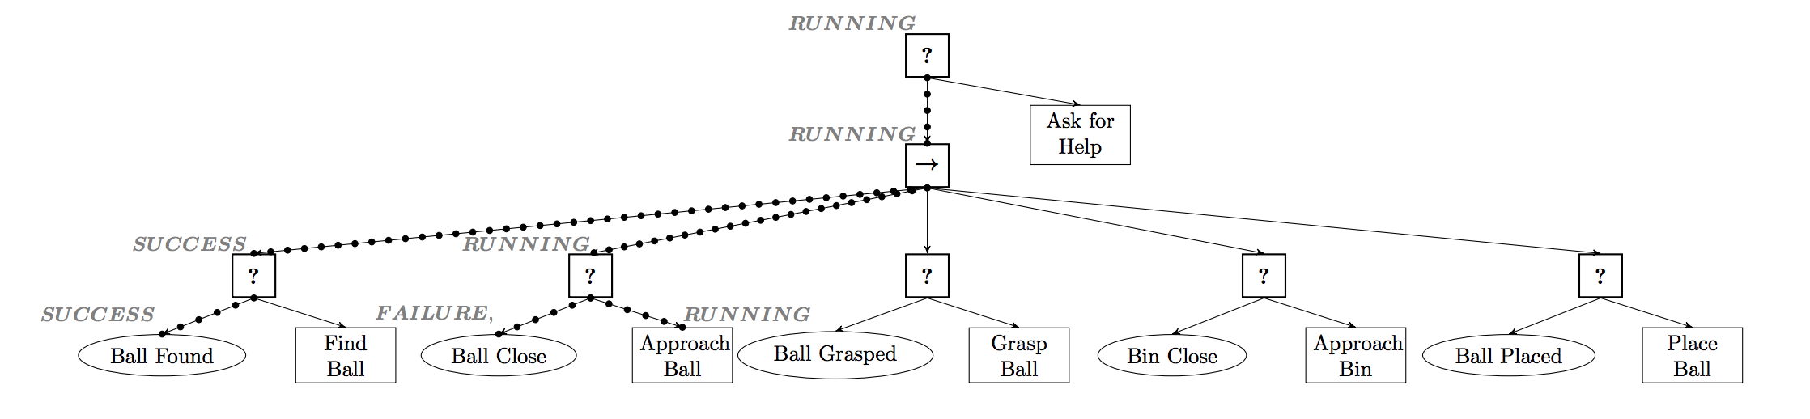
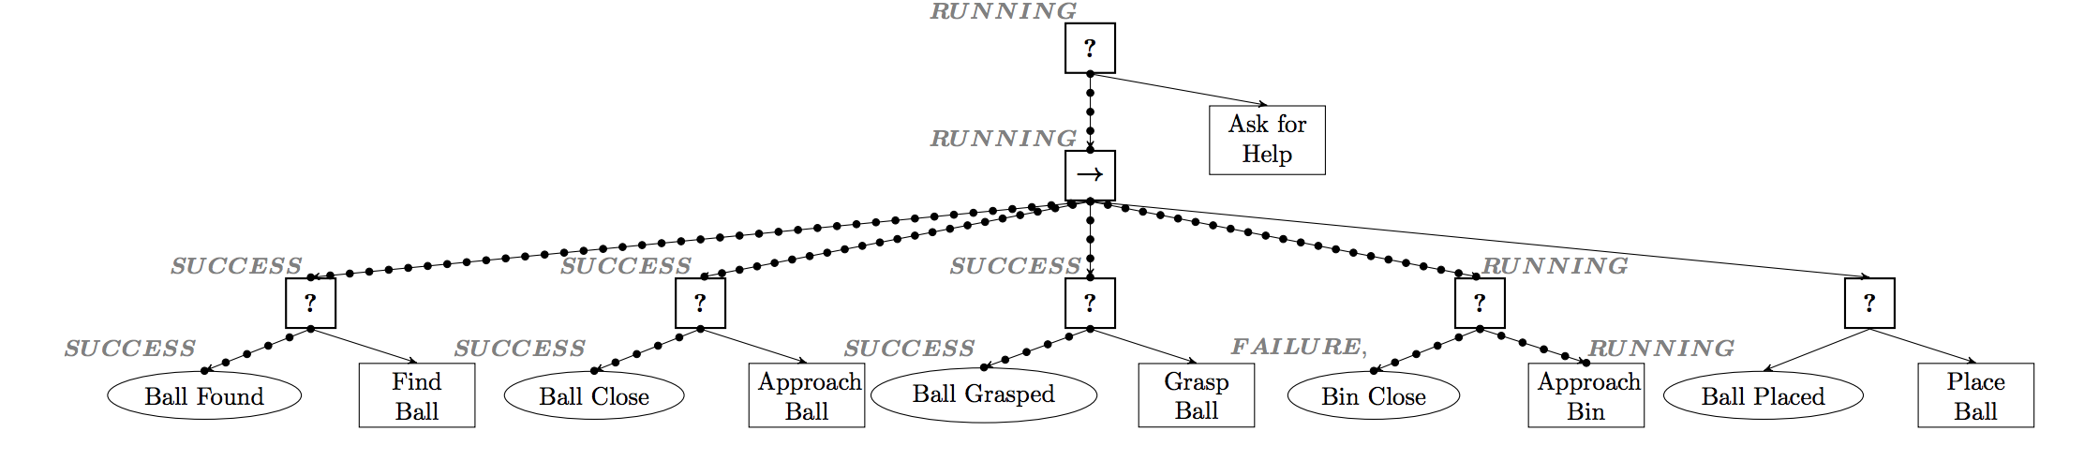
Execution Example of a BT (II)
Figure 2 (b). Ticks’ traversal while the robot is approaching the ball.
Figure 2 (c). The agent eventually reaches the ball, picks it up and goes towards the bin.
Notes:
Figure 2 (b). In this new situation the agent knows the ball position. Hence the condition node Ball Found now returns Success resulting in the ticks no longer reaching the Action node Find Ball and the action is preempted. The ticks continue exploring the tree, and reach the condition node Ball Close, which returns Failure (the ball is far away) and then reach the Action node Approach Ball, which returns Running.

Slide 9
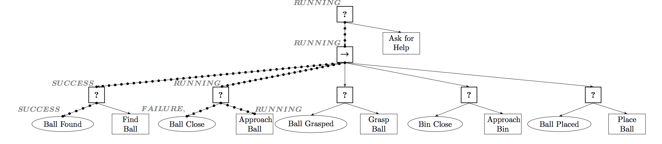
Execution Example of a BT (III)
Figure 2 (d). Ticks’ traversal while the robot is approaching the ball again (because it was removed from the hand).
Notes:
Figure 2 (d). When an external agent moves the ball from the hand of the first agent to the floor, the condition node Ball Found returns Success while the condition node Ball Close returns Failure. In this situation the ticks no longer reach the Action Approach Bin (which is preempted) and they instead reach the Action Approach Bal.

Slide 10
Behavior Trees and Automated Planning
Challenges [3]:
“Hierarchically organized deliberation. This principle goes beyond existing hierarchical planning techniques; its requirements and scope are significantly different. The actor performs its deliberation online”.
“Continual planning and deliberation. The actor monitors, refines, extends, updates, changes and repairs its plans throughout the acting process, using both descriptive and operational models of actions.”
Combining planning with BTs is one way of addressing these challenges.

Slide 11
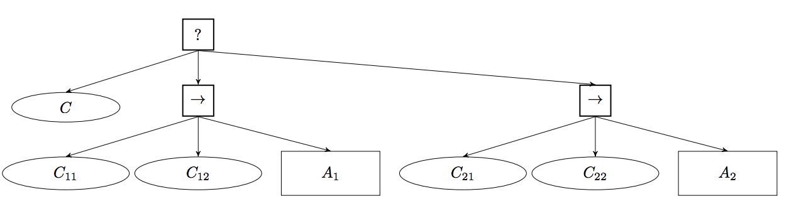
The Planning and Acting (PA-BT) approach
Extension of the Backchaining approach: replace a condition by a small BT achieving that condition, on the form of a PPA BT [4]
Actions are carried out in order to reach a specific goal
Inspired by the Hybrid Backward-Forward (HBF) algorithm and similar to the one of Hierarchical Planning in the Now (HPN) [5]
Figure 3. The Postcondition C can be achieved by either one of actions A1 or A2, which have Preconditions C1i and C2i respectively.

Slide 12
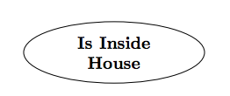
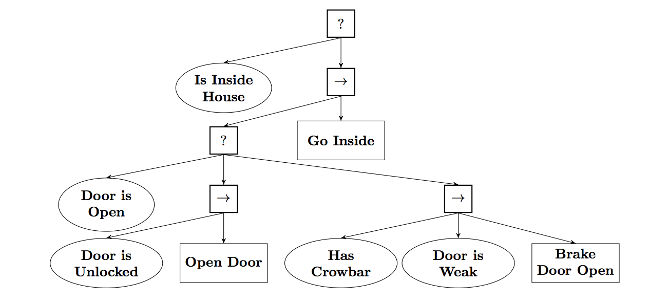
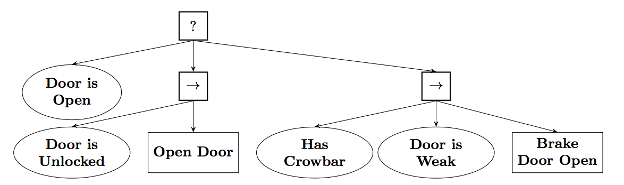
(PA-BT) Approach: Creating Deliberative BTs using Backchaining
Example: agent entering inside a house
Figure 4 (a). A BT composed of a single condition checking if the goal is achieved
Figure 4 (b). PPA for achieving the postcondition Door is Open
Figure 4 (c). The result of replacing Door is Open in Figure 3.8 with the PPA of
Figure 4 (b).
Notes:
Figure 4 (a) PPA for achieving the postcondition Door is Open. If the postcondition is not satisfied, the BT checks the first precondition Door is Unlocked, if so it executes the action Open Door, if not it checks the second set of preconditions, starting with Has Crowbar, if so it checks Door is Weak, if both are satisfied it executes Brake Door Open.

Slide 13
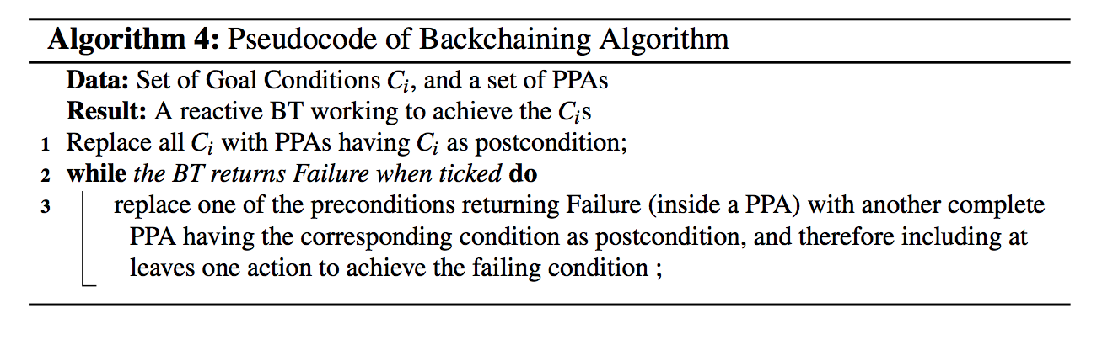
(PA-BT) Approach: Creating Deliberative BTs using Backchaining : The Algorithm
Notes:
Figure 4 (a) PPA for achieving the postcondition Door is Open. If the postcondition is not satisfied, the BT checks the first precondition Door is Unlocked, if so it executes the action Open Door, if not it checks the second set of preconditions, starting with Has Crowbar, if so it checks Door is Weak, if both are satisfied it executes Brake Door Open.

Slide 14
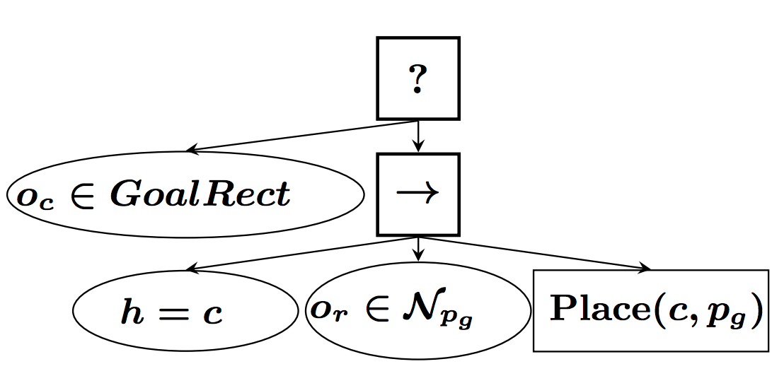
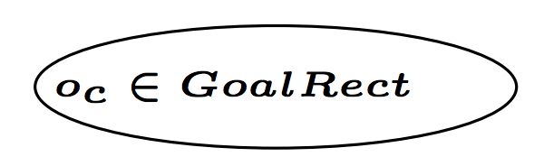
(PA-BT) Approach: Creating Deliberative BTs using Backchaining
Example (II): move the green cube into the rectangle marked GOAL
Figure 5 (a). Initial BT
Figure 5 (b). BT after one iteration of Algorithm 4.
Notes:
The BT in Figure 7.2e is executed, and in each time step the root of the BT is ticked. The root is a Fallback node, which ticks is first child, the condition oc ∈ GoalRect (cube on goal). If the cube is indeed in the rectangle we are done, and the BT returns Success. If not, the second child, a Sequence node, is ticked. The node ticks its first child, which is a Fallback, which again ticks its first child, the condition h = c (object in hand is cube). If the cube is indeed in the hand, the Condition node returns Success, its parent, the Fallback node returns Success, and its parent, the Sequence node ticks its second child, which is a different Fallback, ticking its first child which is the condition or ∈ Npg (robot in the neighborhood of pg). If the robot is in the neighborhood of the goal, the condition and its parent node (the Fallback) returns Success, followed by the sequence ticking its third child, the action Place(c, pg) (place cube in a position pg on the goal), and we are done. If or ∈ Npg does not hold, the action MoveTo(pg, τg) (move to position pg on the goal region using the trajectory τg) is executed, given that the trajectory is free τ ⊂CollFree. Similarly, if the cube is not in the hand, the robot does a MoveTo(pc, τc) (move to cube, using the trajectory τc) followed by a Pick(c) after checking that the hand is empty, the robot is not in the neighborhood of c and that the corresponding trajectory is free. We conclude the example by noting that the BT is ticked every timestep, e.g. every 0.1 second. Thus, when actions return Running (i.e. they are not finished yet) the return status of Running is progressed up the BT and the corresponding action is allowed to control the robot. However, if e.g., the cube slips out of the gripper, the condition h = c instantly returns Failure, and the robot starts checking if it is in the neighborhood of the cube or if it has to move before picking it up again.

Slide 15
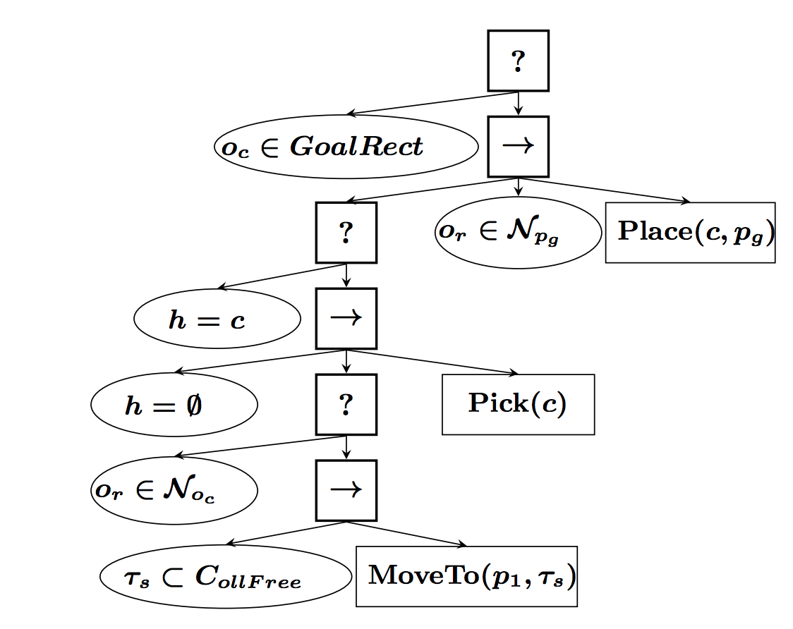
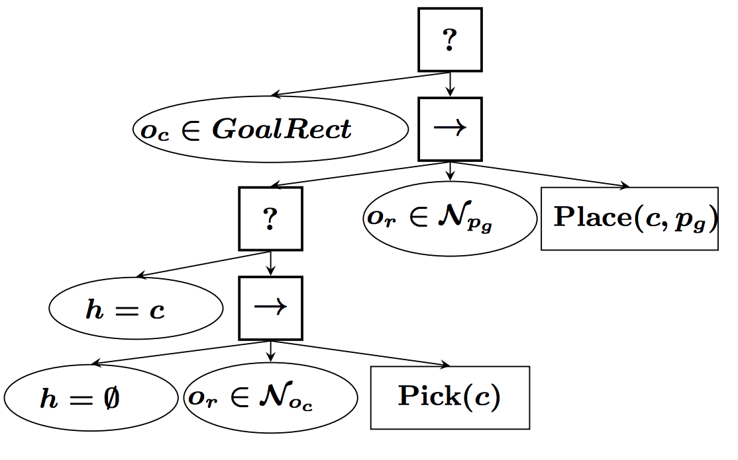
(PA-BT) Approach: Creating Deliberative BTs using Backchaining
Example (II): move the green cube into the rectangle marked GOAL
Figure 5 (c). BT after two iterations.
Figure 5 (d). BT after three iterations.
Notes:
The BT in Figure 7.2e is executed, and in each time step the root of the BT is ticked. The root is a Fallback node, which ticks is first child, the condition oc ∈ GoalRect (cube on goal). If the cube is indeed in the rectangle we are done, and the BT returns Success. If not, the second child, a Sequence node, is ticked. The node ticks its first child, which is a Fallback, which again ticks its first child, the condition h = c (object in hand is cube). If the cube is indeed in the hand, the Condition node returns Success, its parent, the Fallback node returns Success, and its parent, the Sequence node ticks its second child, which is a different Fallback, ticking its first child which is the condition or ∈ Npg (robot in the neighborhood of pg). If the robot is in the neighborhood of the goal, the condition and its parent node (the Fallback) returns Success, followed by the sequence ticking its third child, the action Place(c, pg) (place cube in a position pg on the goal), and we are done. If or ∈ Npg does not hold, the action MoveTo(pg, τg) (move to position pg on the goal region using the trajectory τg) is executed, given that the trajectory is free τ ⊂CollFree. Similarly, if the cube is not in the hand, the robot does a MoveTo(pc, τc) (move to cube, using the trajectory τc) followed by a Pick(c) after checking that the hand is empty, the robot is not in the neighborhood of c and that the corresponding trajectory is free. We conclude the example by noting that the BT is ticked every timestep, e.g. every 0.1 second. Thus, when actions return Running (i.e. they are not finished yet) the return status of Running is progressed up the BT and the corresponding action is allowed to control the robot. However, if e.g., the cube slips out of the gripper, the condition h = c instantly returns Failure, and the robot starts checking if it is in the neighborhood of the cube or if it has to move before picking it up again.

Slide 16
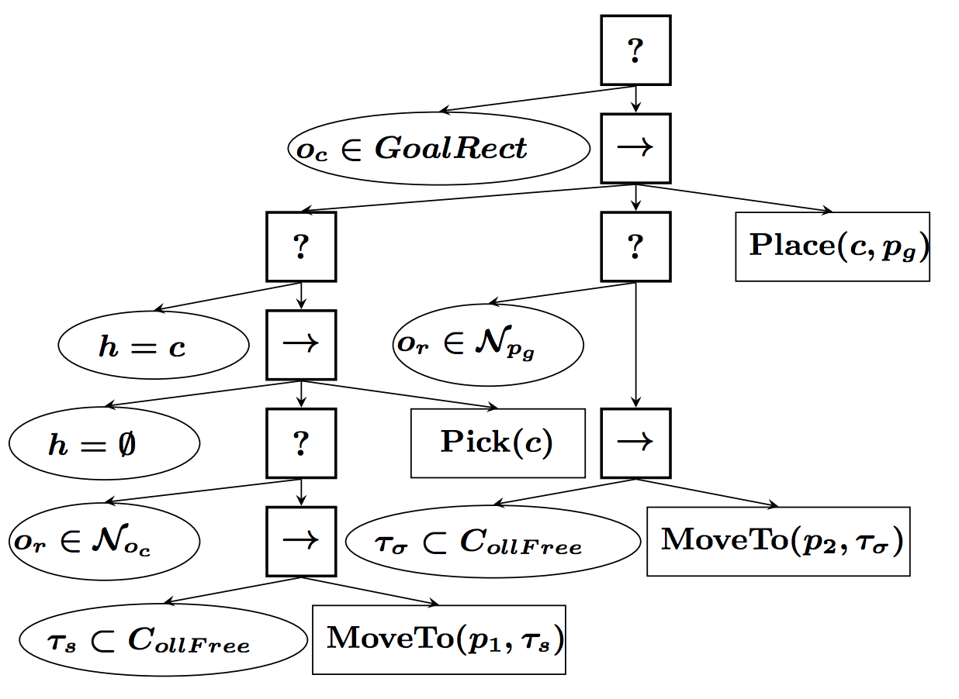
(PA-BT) Approach: Creating Deliberative BTs using Backchaining
Example (II): move the green cube into the rectangle marked GOAL
Figure 5 (c). Final BT.
Notes:
The BT in Figure 7.2e is executed, and in each time step the root of the BT is ticked. The root is a Fallback node, which ticks is first child, the condition oc ∈ GoalRect (cube on goal). If the cube is indeed in the rectangle we are done, and the BT returns Success. If not, the second child, a Sequence node, is ticked. The node ticks its first child, which is a Fallback, which again ticks its first child, the condition h = c (object in hand is cube). If the cube is indeed in the hand, the Condition node returns Success, its parent, the Fallback node returns Success, and its parent, the Sequence node ticks its second child, which is a different Fallback, ticking its first child which is the condition or ∈ Npg (robot in the neighborhood of pg). If the robot is in the neighborhood of the goal, the condition and its parent node (the Fallback) returns Success, followed by the sequence ticking its third child, the action Place(c, pg) (place cube in a position pg on the goal), and we are done. If or ∈ Npg does not hold, the action MoveTo(pg, τg) (move to position pg on the goal region using the trajectory τg) is executed, given that the trajectory is free τ ⊂CollFree. Similarly, if the cube is not in the hand, the robot does a MoveTo(pc, τc) (move to cube, using the trajectory τc) followed by a Pick(c) after checking that the hand is empty, the robot is not in the neighborhood of c and that the corresponding trajectory is free. We conclude the example by noting that the BT is ticked every timestep, e.g. every 0.1 second. Thus, when actions return Running (i.e. they are not finished yet) the return status of Running is progressed up the BT and the corresponding action is allowed to control the robot. However, if e.g., the cube slips out of the gripper, the condition h = c instantly returns Failure, and the robot starts checking if it is in the neighborhood of the cube or if it has to move before picking it up again.

Slide 17
Noten (VO)
VO Test am Ende des Semester
Termin 1: Mo. 03.02.2020 9:00 – 12:00, Rechnerräume
Termin 2: Fr. 28.02.2020 9:00 – 12:00, Rechnerräume
Termin 3: Mo. 20.04.2020 9:00 – 12:00, Rechnerräume

Slide 18
Täuschungsversuche
Gruppenarbeit ist nicht erlaubt (kein Kavaliersdelikt)
Kopieren von Lösungen
Schummeln bei Tests
Überprüfung
Stichproben + Plagiatstest
Verständnis bei Präsentationen
Sanktionen
1. Vorfall: Verfall der Punkte des Übungsblattes
2. Vorfall: negative Beurteilung des Seminars

Slide 19
Anwesenheit
Anwesenheitspflicht
2x entschuldigtes Fehlen möglich
Unentschuldigtes Fehlen führt zu negativer Note
Entschuldigung vorab per Email (kein Attest nötig)
Keine Punkte wenn nicht Anwesend
Bei entschuldigter Abwesenheit gibt es aber die Möglichkeit die Aufgaben in der Sprechstunde (Anfrage per Email) zu präsentieren um die Punkte dennoch zu erhalten
Keine Abmeldung möglich
Ab erster Abgabe (nächste Woche) wird eine Note vergeben

Slide 20
References
[1] Michele Colledanchise and Petter Ogren. Behavior Trees in Robotics and AI. An Introduction. arXiv:1709.00084v3 [cs.RO] 15 Jan 2018.
[2] Edsger W. Dijkstra. Letters to the editor: go to statement considered harmful. Commun. ACM, 11:147–148, March 1968.
[3] Malik Ghallab, Dana Nau, and Paolo Traverso. The actor’s view of automated planning and acting: A position paper. Artif. Intell., 208:1–17, March 2014.
[4] Caelan Reed Garrett, Tomas Lozano-P ´ erez, and Leslie Pack Kaelbling. Backward-forward ´ search for manipulation planning. In Intelligent Robots and Systems (IROS), 2015 IEEE/RSJ International Conference on, pages 6366–6373. IEEE, 2015.
[5] Leslie Pack Kaelbling and Tomas Lozano-P ´ erez. Hierarchical task and motion planning in ´ the now. In Robotics and Automation (ICRA), 2011 IEEE International Conference on, pages 1470–1477. IEEE, 2011.

